Slide 1
Music and Interaction Development Using the Countess Quanta Robot
Brad Pitney
Yin Shi
Chal McCollough

Slide 2
Areas of Development
IGA-based Motion Generation
Person Tracking with Kinect
Right Arm Kinematics Modeling

Slide 3
IGA-based Motion Generation
Extends existing music functionality.
Allows robot to lift its hand while playing.
Uses IGA to evolve songs based on user rating.

Slide 4
Move Representation
Robot lifts hand off of the strings.
Robot lowers hand onto the strings.
Robot moves raised hand above the strings, to a new position.
Robot moves lowered hand across the strings, strumming the instrument.

Slide 5
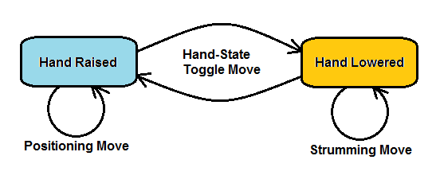
Move Simplification
Hand-state toggling move.
Positioning/strumming move.

Slide 6
IGA Structure
Gene = 1 move
Chromosome = sequence of 10 moves
Population = set of 10 chromosomes
Move object contains:
toggleHandState – Boolean
wristPosition – integer, 600 to 1300

Slide 7
Fitness Evaluation
Robot plays song for the viewer.
Performs sequence of moves.
Viewer rates the quality of the song on a scale from 1 to 9.

Slide 8
Creating Next Generation
Roulette wheel parent selection.
60% chance of 2-point crossover.
1% chance of mutation.

Slide 9
Good Song 1
Repositioning hand to 1174.
Lowering hand onto strings.
Strumming strings to 1113.
Strumming strings to 1288.
Strumming strings to 740.
Strumming strings to 1201.
Strumming strings to 685.
Raising hand off of strings.
Lowering hand onto strings.
Strumming strings to 806.

Slide 10
Good Song 2
Lowering hand onto strings.
Strumming strings to 1251.
Raising hand off of strings.
Skipping superfluous move to 1074.
Skipping superfluous move to 1211.
Skipping superfluous move to 769.
Skipping superfluous move to 1151.
Repositioning hand to 775.
Lowering hand onto strings.
Strumming strings to 1088.

Slide 11
Bad Song 1
Lowering hand onto strings.
Raising hand off of strings.
Repositioning hand to 1154.
Lowering hand onto strings.
Raising hand off of strings.
Lowering hand onto strings.
Raising hand off of strings.
Repositioning hand to 1052.
Lowering hand onto strings.
Strumming strings to 1136.

Slide 12
Bad Song 2
Lowering hand onto strings.
Raising hand off of strings.
Skipping superfluous move to 1214.
Skipping superfluous move to 632.
Skipping superfluous move to 1168.
Skipping superfluous move to 671.
Skipping superfluous move to 1146.
Repositioning hand to 1015.
Lowering hand onto strings.
Strumming strings to 763.

Slide 13
Subjective Rating System
‘Good’ song features:
Enthusiastic strumming.
Repositions hand between strums.
‘Bad’ song features:
Few moves (move pruning).
Little motion (short strum distances).
‘Patting’ the strings (chains of toggle moves).

Slide 14
IGA Performance
Standard GA Trial 1
Generation: | 1 | 2 | 3 | 4 | 5
 | 2 | 3 | 6 | 2 | 5
 | 2 | 3 | 2 | 5 | 5
 | 3 | 4 | 2 | 1 | 5
 | 5 | 2 | 5 | 7 | 3
New | 6 | 1 |  | 5 | 6
Ratings: | 2 | 2 |  | 5 | 6
 | 3 | 5 |  | 6 | 6
 | 2
 | 1
 | 5
Average: | 3.10 | 2.86 | 3.75 | 4.43 | 5.14

Slide 15
IGA Performance

Slide 16
IGA Comparison
Compared 3 GAs:
“Standard GA” – 60% crossover, 1% mutation
“Mutation GA” – 0% crossover, 30% mutation
“Random Motion” – 0% crossover, 100% mutation

Slide 17
IGA Comparison

Slide 18
Person Tracking with Kinect
Extends human-interaction capabilities.
Uses Kinect to track the position of a viewed person.
Robot rotates head to face the target.
Uses simulated Countess Quanta robot.

Slide 19
Design Process
Ran into problems getting Kinect to work with Ubuntu 12.04.
Implemented feature in Windows 7 using Microsoft’s ‘Kinect for Windows SDK v1.8’.
Extended ‘SkeletonBasics-WPF’ sample program from ‘Kinect for Windows Developer Toolkit v1.8’.

Slide 20
Design Process
Kinect tracks skeleton joints of viewed target.
New RobotDisplay form gets XYZ coordinates of ‘Head’ joint.
Displays top-down view of simulated robot and target person.
Calculates robot head rotation.

Slide 21
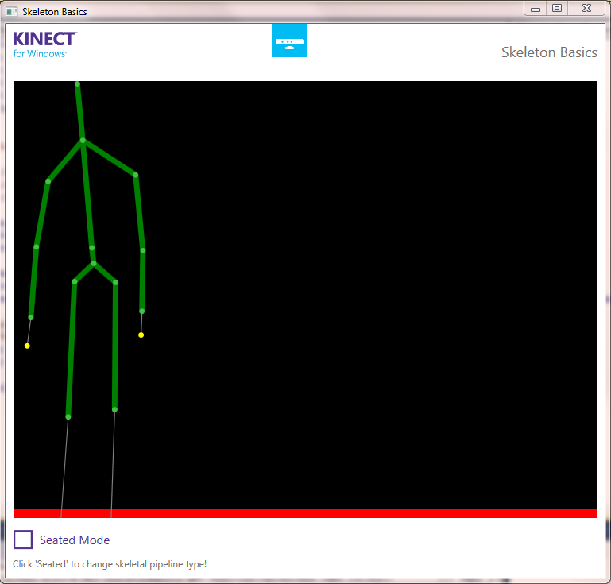
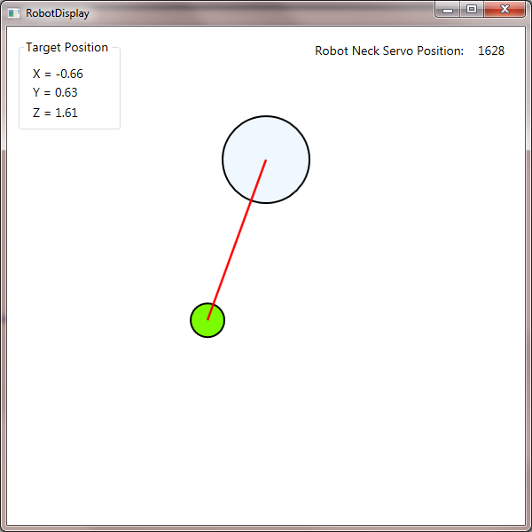
Example Output 1

Slide 22
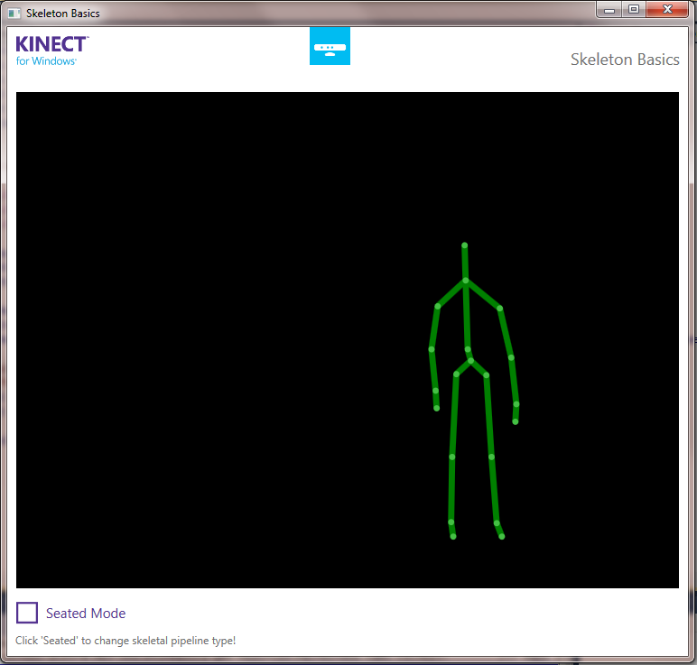
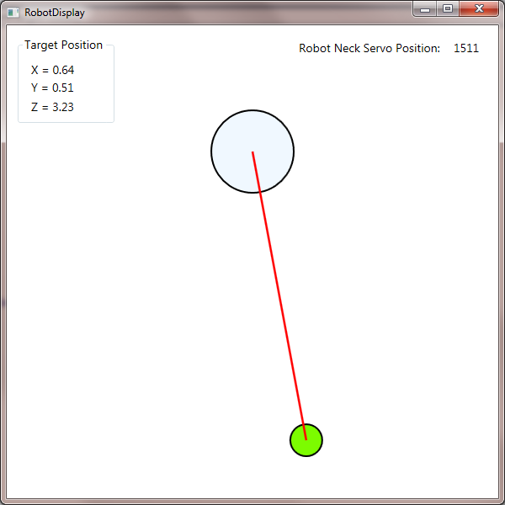
Example Output 2

Slide 23
Calculating Servo Rotation
Robot head rotation uses Servo 10.
Range is 1350 (left) to 1750 (right)
1550 center position.
1550 – arctan(target.X / target.Z) * increment per radian
Will need to be calibrated.

Slide 24
Future Development
Connect to robot hardware.
Add vertical tracking.
Multiple target support.
Gesture recognition from target.
Use eyes, head, and/or base to turn.
Servo velocity control (robot is alert/tired).
Looks away if distracted/uninterested.

Slide 25
Right Arm Kinematics Modeling
Feature is still in development.
Intended functionality:
Support 3D rendering of arm.
Support moving end effector using Cartesian coordinates.
Support robot playing keyboard instrument.

Slide 26
Progress so far
Measurement of servo directions and physical limits.
Measurement of arm segments between servo joints.
Some software is in development.

Slide 27
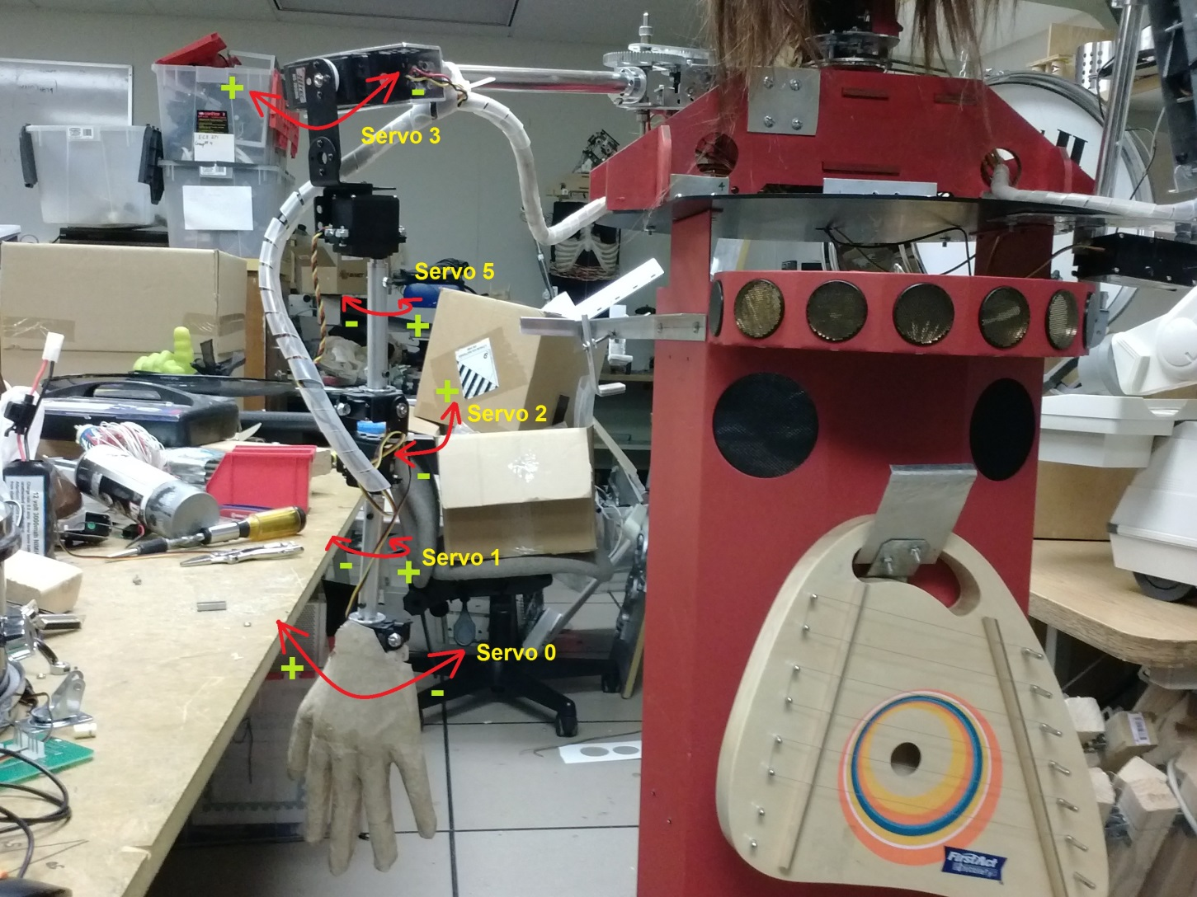
Servo Directions

Slide 28
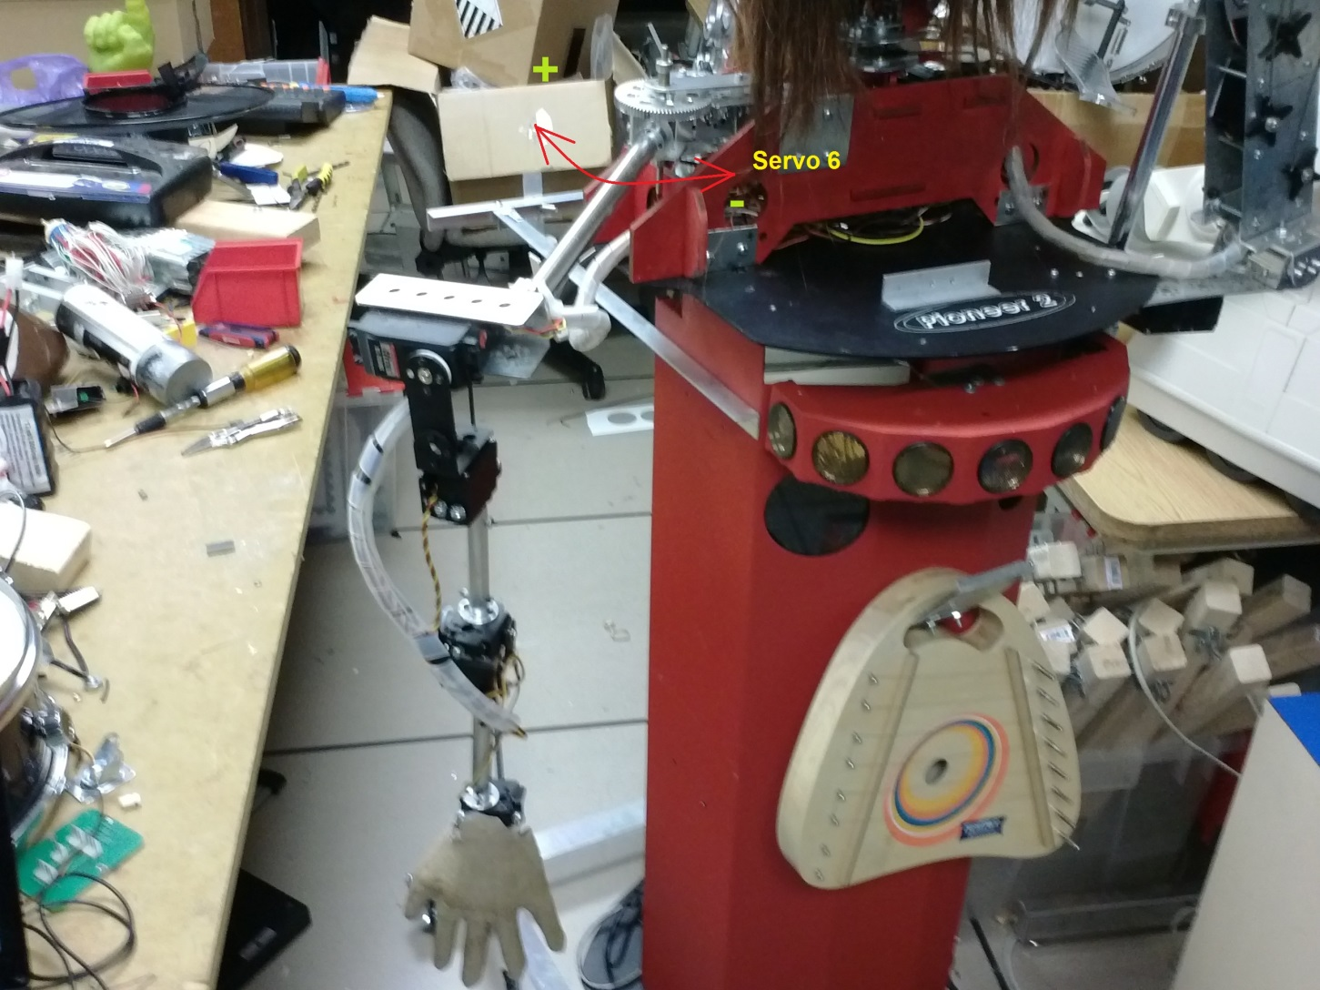
Servo Directions

Slide 29
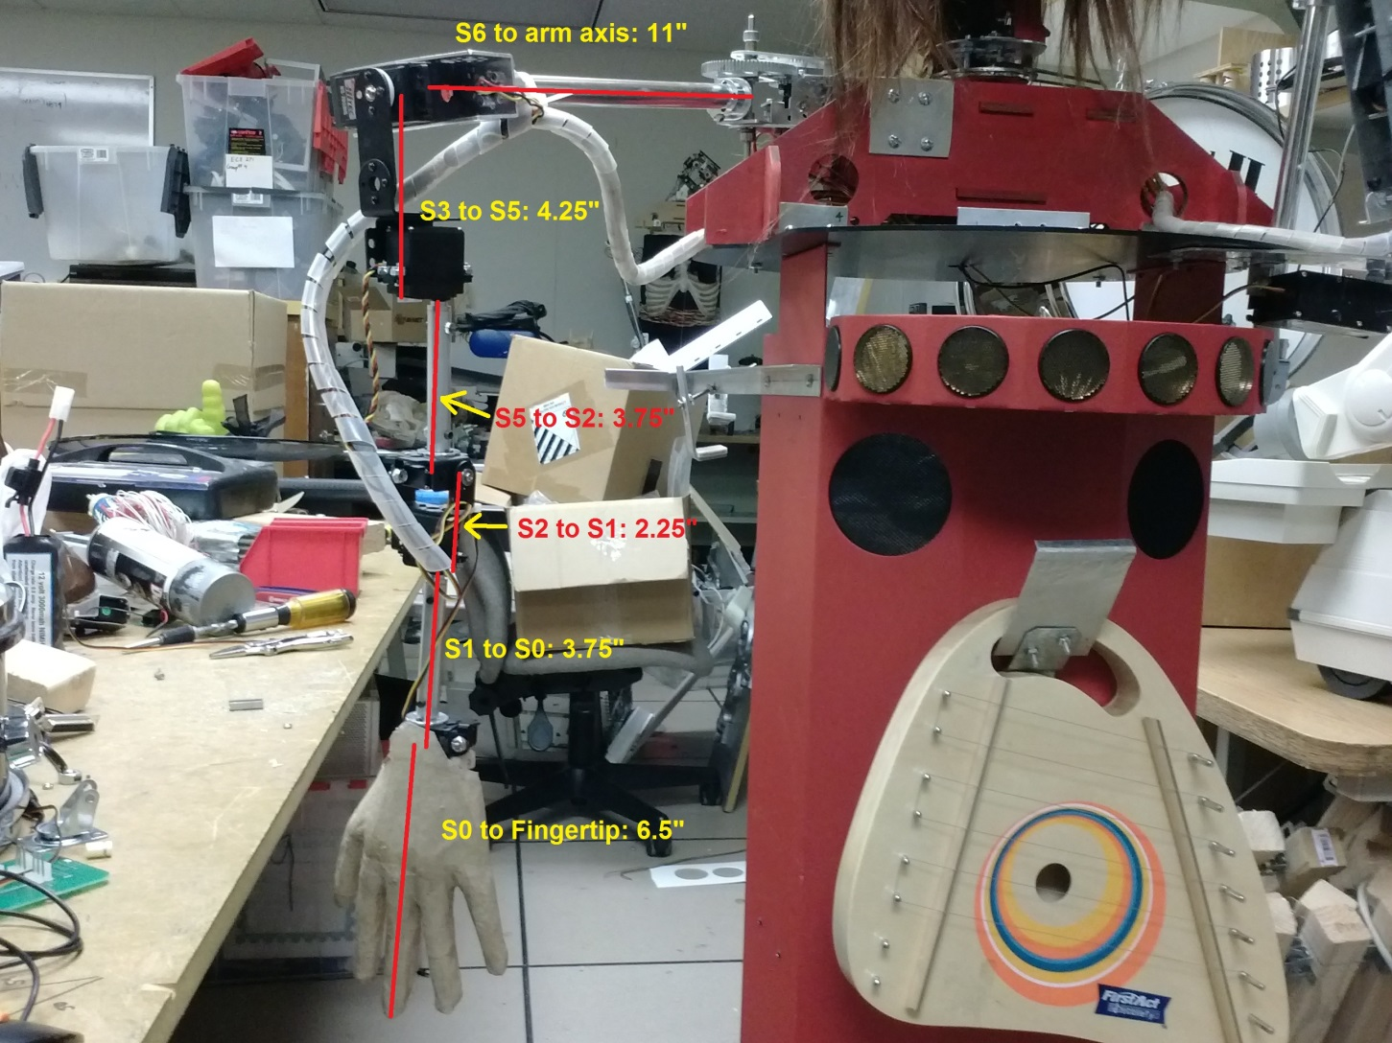
Length Measurements

